Slide 1

MASTER IN DATA SCIENCE MANAGEMENT
Customer Demographics Analyses for Product Recommendations A Case Study of Bokku Stores
VELENZO GROUP 2
IBEABUCHI IKEM OKWUCHUKWU | 24ODS2109II74
NWAFOR PEREMOBO BLESSING | 24ODS3452NP52
ADEOLA SIMISOLA ESTHER | 24ODS1011AS99

Slide 2
Presentation Outline
Background of the Study
Literature Review
Methodology
Results
Conclusion
References

Slide 3

Background of the Study
Nigerian Retail & Bokku Stores
Retail sector transforming; e-commerce hitting $14.1B by 2027 (103M+ users)
Bokku Stores: strong position but faces overcrowding & unused customer data
Solution: apply demographics + machine learning to personalize products, boost sales, optimize stock, and enhance satisfaction

Slide 4
Problem Statement
Bokku Stores collects extensive demographic and transaction data, but lacks a personalized recommendation system.
This gap leads to:
Overcrowding and poor customer flow in key outlets
Generic recommendations that ignore customer attributes
Wasted inventory and missed upsell opportunities

Slide 5
Literature Review
Customer Demographics & Retail:
Age, gender, income, and location strongly influence consumer purchasing patterns.
In Nigeria, targeted marketing is critical due to diverse socio-economic conditions.
Recommendation Systems:
Traditional Methods: Collaborative & content-based filtering; issues with cold start & data sparsity.
ML & Hybrid Models: Integrate demographics, outperform traditional methods; Park et al. (2019) showed a 17% targeting accuracy increase.
Literature Gaps:
Few Nigerian/African studies using ML + demographics for recommendations.
Need for localized, data-driven frameworks that match infrastructure realities.

Slide 6
Literature Review Related works
Author(s) & Year | Problem Addressed | Approach Used | Gap / Limitation
Park et al. (2019) | Generic recommendations ignoring demographics | Integrated age, gender, location into recommender system | Focused on e-commerce; no retail store case study
Al-Gasawneh et al. (2021) | Underutilization of customer data in emerging markets | Customer segmentation using demographic attributes | Did not implement real-time recommendation system
Padlee et al. (2019) | Inefficient demographic targeting in retail marketing | Demographic segmentation to improve campaign response | Did not combine demographic and transaction data
Table 1: outlines prior studies, their focus, and gaps, highlighting the need for our demographic-based real-time recommendation system.

Slide 7

Methodology Data & Preparation
Research Method
Design: Quantitative + predictive ML modeling
Data: POS, CRM, loyalty records from 6 branches (38,765 transactions)
Preprocessing: Clean missing values, encode categories, standardize prices, drop duplicates
EDA Focus: Age/gender distribution, top products & locations, spend patterns

Slide 8
Methodology Data & Preparation
Research Design
Data Collection
POS, CRM, and loyalty program data from 6 Bokku Stores branches (38,765 transactions).
Data Preprocessing
Remove missing values (critical fields: Product Price, Items). Encode categorical variables (Gender, Items, Location). Standardize prices (remove ₦ symbol). Drop duplicates & irrelevant columns.
Exploratory Data Analysis (EDA)
Age & gender distribution Top products & locations Spend patterns
Quantitative + Predictive modeling using ML algorithms.

Slide 9
Methodology Modeling & Tools
Model Development
Logistic Regression Decision Tree Random Forest
Model Evaluation
Accuracy
Tools Used
Python
Precision
Recall
F1-score
Confusion Matrix.
Pandas
Scikit-learn
Excel
Matplotlib
Seaborn.

Slide 10
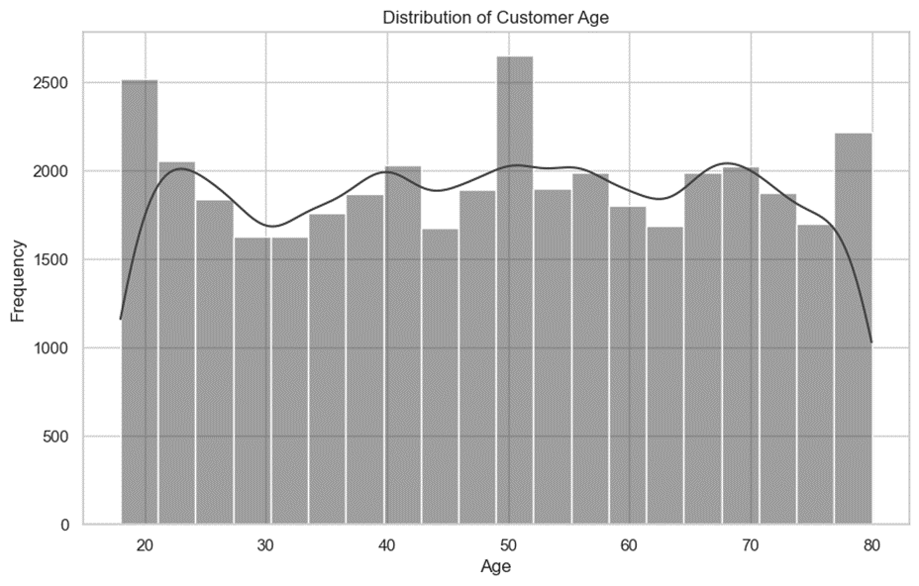
Results EDA Insights
Fig 1 : Shopping frequency by age group.
The chart indicates that the highest shopping activity occurs among customers aged 25 – 45 years, identifying them as the store’s core shopper segment.

Slide 11
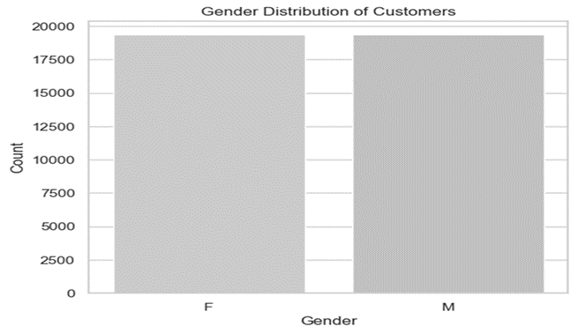
Results EDA Insights
Fig 2: Customer count by gender.
The gender distribution is nearly equal; however, male customers tend to spend more per visit compared to female customers.

Slide 12
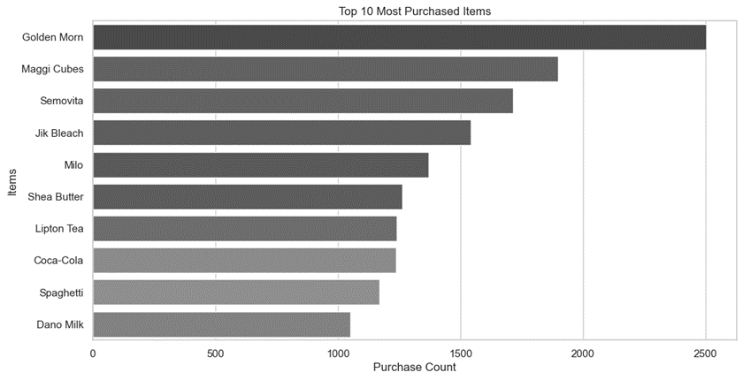
Results EDA Insights
Fig 3: Purchase count by item.
The most frequently purchased products are Golden Morn, Maggi Cubes, and Semovita.

Slide 13
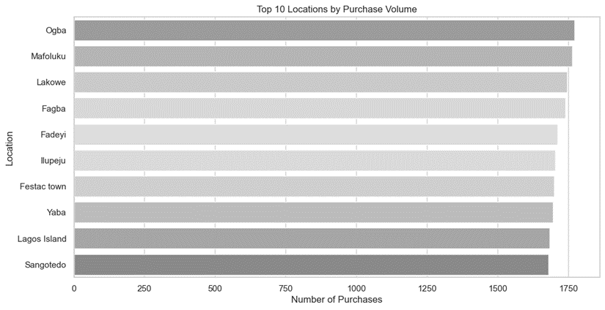
Results EDA Insights
Fig 4 : Number of purchases by location.
The highest purchase volumes are recorded in Ogba, Mafoluku, and Lakowe, identifying them as key sales hotspots.

Slide 14
Results Model Performance Comparison
Model | Accuracy | Precision | Recall | F1-Score
Logistic Regression | 72.6% | Moderate | Low | Fair
Decision Tree | 83.44% | High | High | Excellent
Random Forest | 80.29% | High | Consistent | Balanced
Table 2: compares model performance metrics, showing Decision Tree as the most accurate and Random Forest as the most deployment-ready.

Slide 15
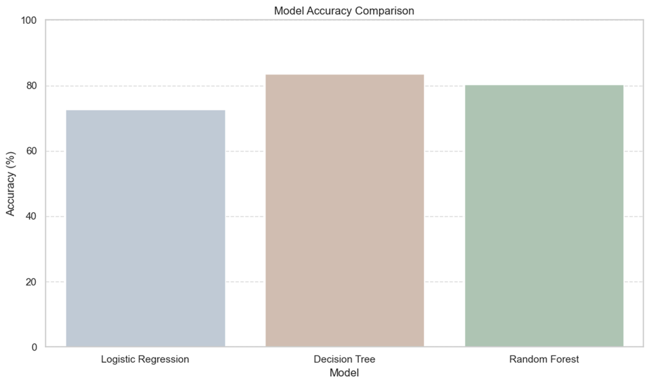
Results Model Performance Comparison (Pictorial View)
Fig 5: Model accuracy comparison.
Among all models tested, Decision Tree achieved the highest accuracy, followed closely by Random Forest.

Slide 16
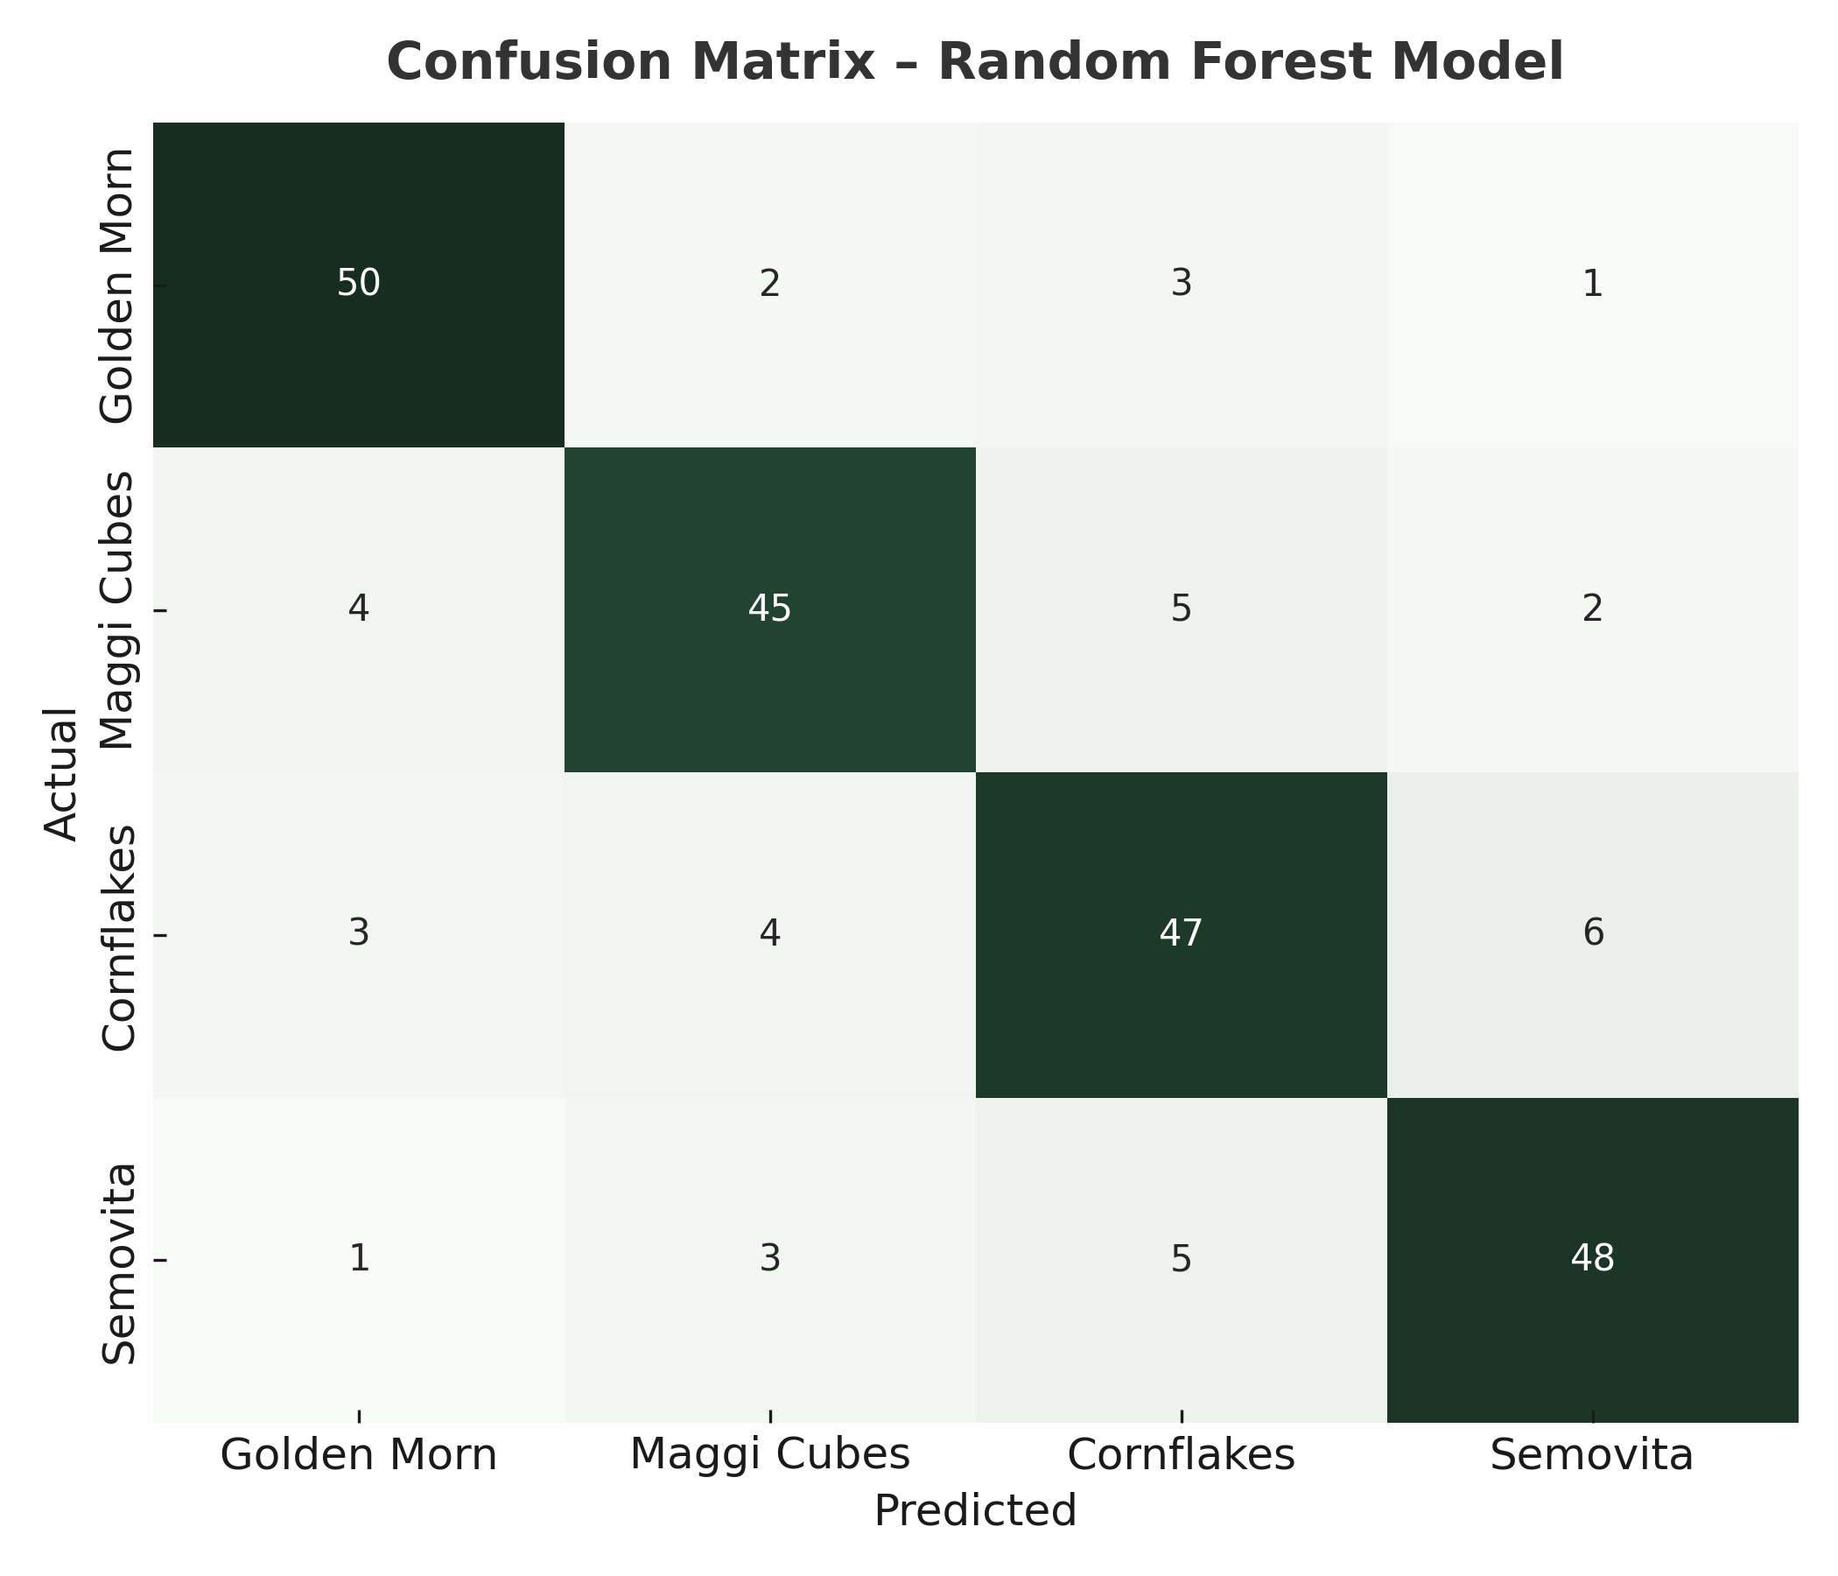
Results Confusion Matrix – Random Forest Model
Metric | Result
Accuracy | 85%
Precision | 0.89 (Golden Morn)
Recall | 0.84
F1 Score | 0.86
Table 3 & Fig 6: Confusion matrix for the Random Forest model.
This model showed strong and balanced classification performance, making it more reliable for real-world deployment.

Slide 17
Results Business Insights from Model Output
Analysis confirms that age and location are the most influential predictors of purchase behavior.
High-demand branches (Ogba, Mafoluku, Lakowe) should get inventory priority.
Middle-aged male shoppers show potential for bulk purchase promotions, while essentials like Golden Morn and Maggi are ideal loyalty reward triggers.
Integrating the recommendation system into POS can enable real-time suggestions at checkout.

Slide 18
Conclusion
This study proves that even with basic demographic data, Bokku Stores can accurately predict customer preferences and make smarter business decisions. By choosing the Random Forest model, we’ve prioritized not just accuracy, but long-term reliability. The next step is to integrate this system into real-time operations transforming every checkout into an opportunity for smarter stocking, targeted marketing, and stronger customer loyalty.

Slide 19
References
Park, S., Kim, Y., & Choi, H. (2019). Enhancing recommendation systems with demographic data. Journal of Retail Analytics, 15(3), 45–58.
Al-Gasawneh, J., Anuar, M. M., & Dacko-Pikiewicz, Z. (2021). Customer data utilization in emerging markets: A retail perspective. Marketing Intelligence & Planning, 39(5), 625–641.
Padlee, S. F., Thaw, C. Y., & Abdul Rashid, Z. (2019). Demographic segmentation and its influence on purchase decisions. International Journal of Retail & Distribution Management, 47(11), 1161–1177.
(Full reference list available in project report)

Slide 20


